Slide 1

Image Classification of Artworks based on their Creation Date
Slot F+TF
||
Group number: 7

Slide 2
Group Members:
Abhay Chaudhary 19BCE7290
Anish Kumar 19BCE7272
Sarthak Bansal 19BCE7321
Sankalp Gupta 19BCE7596
Vaibhav Sharma 19BCE7619

Slide 3

Abstract
In the past couple of decades, millions of photographs have been digitised. It has offered art critics and historians new possibilities. The lack of metadata and the semantic details used to identify these images, however, makes it challenging to find and access these art pictures. Finding similar artwork is a challenging job unless one recognises the exact title and creator. This problem is tackled by work in this project through the creation of unattended computer-vision methods that automatically construct metadata from art. More than 300,000 art photographs from our multimedia archive come from three sources: the Metropolitan Museum of Art, WikiArt and media. To achieve sustainability, we plan to create an immersive framework to discover the functionality extracted and to establish a suggestion program for art historians, academics and art lovers.

Slide 4

Introduction
Recent success has been observed by many scholars in the area of picture detection in the field of deep learning. Current neural network models also demonstrate very high performance in target detection and classification. We will use deep learning in this Research Paper to identify artworks on the date of formation.
We have access, when created, for a dataset of paintings and drawings. This knowledge is used first to divide the details into various phases of history. The data is formerly used to train an image recognition model for the neural network based on Convolutional Neural Networks, a typical deep research architecture.

Slide 5
Researchers have historically tried, for example, to identify art dependent on social trends. Based on how traditional, cubist or impressionist pictures are used, Icogly et al. used regular machinery learning algorithms in 2004 to identify them with 90% accuracy. They would still divide paintings into groups, but we can now use recent advances in neural networks to construct a layout dependent on their development date.

Slide 6
Classifying Works of Art from a Historical Standpoint
Classical antiquity (8th century B.C. to 5th century A.D.)
Byzantine art (5th to 15th centuries)
Romanesque art (10th to 13th centuries)
Gothic art (12th to 15th centuries)
Renaissance (13th to 16th centuries)
Baroque (end of 16th to mid-18th centuries)
Rococo (first half of 18th century)
Classicism (17th - the beginning of 19th century)
Romanticism (second half of 18th - first half of 19th century)

Slide 7
Impressionism (the 1860s – beg. of 20th century)
Symbolism (end of 19th – beg. of 20th centuries)
Modern art (end of 19th – beg. of 20th centuries) Cubism (beg. of the 20th century)
Expressionism (beg. of the 20th century)
Futurism (beg. of the 20th century)
Surrealism (early 20th century)
Minimalism (second half of 20th century)

Slide 8
Image 1 “Oath of the Horatii”, Example of Classicism
Image 2 “A Bar at the Folies-Bergère”, Example of Impressionism

Slide 9
Data Overview
Approximately 8,500 paintings were placed under one category.

Slide 11
Pre-processing Metadata
The metadata given contains many data points, but only several of them are of particular significance and can be used for research. The first is to use filenames along with the picture title as a specific identification for an object. The metadata file includes nearly 200,000 data entries. There are also double submissions. They are others. Around 4,000 entries have double-file titles, and over 70,000 entries have double-file names. Moreover, there is no title to around 3,000 pictures. Roughly 125,000 entries are left following the elimination of all duplicates.

Slide 12
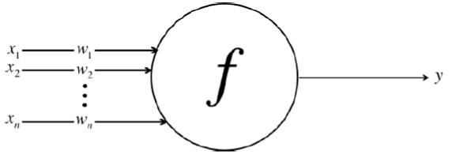
Neural Networks for Image Classification
An input 𝑥 to a neuron has variable strength that can be measured by a numeric weight 𝑤; various inputs are then summed up to produce a so-called logit, transformed into a new signal using a function of a form 𝑦=𝑓(𝑙𝑜𝑔𝑖𝑡) and sent to the next neuron

Slide 13
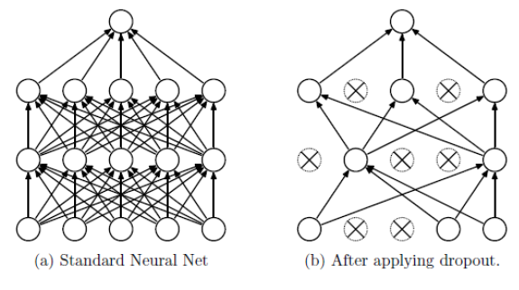
Deep Learning with Convolutional Neural Networks
Face Recognition Features in a Neural Network
Visual Representation of how CNNs Classify Images

Slide 14
Deep Learning Frameworks
The bulk of the accessible implementations are actually in the vocabulary of Python programming. Theano4, Tensorflow5, PyTorch6 and Keras7 are some of the more popular frameworks. Whereas Theano and Tensorflow are more systems of lower rank, which need a detailed understanding of programming and neural networks, Keras is a higher-grade system that can allow the construction of less complex neural architectures. This is a product of three main design frameworks: modularity, with a series of graphic templates for each element in Keras; minimalism; both operations and the GUI are short-term and self-described; extensibility and new features will quickly be expanded for Keras (Pal&Gulli, 2017)
Data Flow Graph Example

Slide 15
Implementation and Evaluation
We’re using Keras as the critical deep learning system to classify paintings and drawings into the groups described above, and are practising on a desktop computer using a 2 Gbps graphical processing device, namely an NVIDIA GPU. Before recently, a robust neural network design could not be built on a desktop machine, and this was only feasible
Custom CNN Architecture
First of all, we seek with a customised CNN architecture to overcome the classification question which we have established over several iterations. Once many versions have been tested, 70 per cent of the right design software architecture can be obtained.

Slide 16
Classifying Paintings, Accuracy and Loss Graph

Slide 17
Classifying Paintings with 500 Training Epochs

Slide 18
Smaller Validation Set Reaches 100% Accuracy

Slide 19
Classifying Drawings, Accuracy and Loss Graph

Slide 20
Augmenting Transfer Learning Models
We use the current VGG19 model (Simonyan & Zisserman, 2014) to improve the precision and apply it to our classification issue instead of pursuing studies on unique CNN architectures. Regrettably, because of the shortage of computing resources on our desktop Computer, the VGG model itself can not be run so it will know all the hyperparameters in this dataset. Transfer learning allows us to improve the accuracy of 70% to 75% of paintings and of drawing datasets for detailed losses and accuracy visualisations), from 55% to 62%.
Classifying Paintings with VGG19, Accuracy and Loss Graph

Slide 21
Classifying Drawings with VGG19, Accuracy and Loss Graph

Slide 22
The question of automatically classifying artworks depending on their date of origin was addressed in this Research Paper. We also collected a list of nearly 7,000 colour paintings from different historical times, along with 7,500 grayscale paints and a related dataset.
Through using CNC, we could achieve an accuracy of 76 per cent in grading pictures into three historical phases (yourself in 1400-1759, 1760-1870 and 1870 to the present day), whereas a precision of 62 per cent could be achieved in classifying pictures in five historical phases (1400-1599, 1600-1650, 1651-1719, 1720-1799, 1800).
This distinction is a complicated issue because there are few picture samples in the dataset. To order to avoid the creation of more complicated CNN architectures, we have also equipped neural network models on a computer. Research on this deeper classification issue might theoretically increase its reliability, but a more extensive dataset might hopefully lead to more reliable performance.
Further research may be performed in the area of the transference of the neural types, which Gatys et al. first introduced in 2015, where a neural network is capable of catching the visual style of an image and converting it into a specific picture because this method involves substantial study and testing in philosophy and theoretical application.
Conclusion and Future Work

Slide 23
References
Buduma, N., & Lacascio, N. (2017). Fundamentals of Deep Learning. O’Reilly Media, Inc.
Chollet, F. (2015). Keras. GitHub. Retrieved from https://github.com/fchollet/keras
Gatys, L., Ecker, A., & Bethge, M. (2015). A Neural Algorithm of Artistic Style. ArXiv e-print
Hess, D., & Hirschfelder, D. (2010). Barock. Renaissance. Aufklärung. Kunst und Kultur vom 16. bis zum 18. Jahrhundert. Germanisches Nationalmuseum Abt. Verlag.
Hodge, S. (2014). 50 Schlüsselideen Kunst. Springer-Verlag.
Icoglu, O., Gunsel, B., & Sariel, S. (2004). Classification and Indexing of Paintings Based on Art Movements. Signal Processing Conference. Vienna: IEEE.
P. F. Felzenszwalb, R. B. Girshick, D. Mcallester, and D. Ramanan, “Object detection with discriminatively trained part-based models,” IEEE Trans. Pattern Anal. Mach. Intell., vol. 32, no. 9, p. 1627, 2010.
K. K. Sung and T. Poggio, “Example-based learning for view-based human face detection,” IEEE Trans. Pattern Anal. Mach. Intell., vol. 20, no. 1, pp. 39–51, 2002.
C. Wojek, P. Dollar, B. Schiele, and P. Perona, “Pedestrian detection: An evaluation of the state of the art,” IEEE Trans. Pattern Anal. Mach. Intell., vol. 34, no. 4, p. 743, 2012.
H. Kobatake and Y. Yoshinaga, “Detection of spicules on mammogram based on skeleton analysis.” IEEE Trans. Med. Imag., vol. 15, no. 3, pp. 235–245, 1996.
Y. Jia, E. Shelhamer, J. Donahue, S. Karayev, J. Long, R. Girshick, S. Guadarrama, and T. Darrell, “Caffe: Convolutional architecture for
fast feature embedding,” in ACM MM, 2014.
A. Krizhevsky, I. Sutskever, and G. E. Hinton, “Imagenet classification with deep convolutional neural networks,” in NIPS, 2012.
Z. Cao, T. Simon, S.-E. Wei, and Y. Sheikh, “Realtime multi-person 2d pose estimation using part affinity fields,” in CVPR, 2017.

